Slide 1
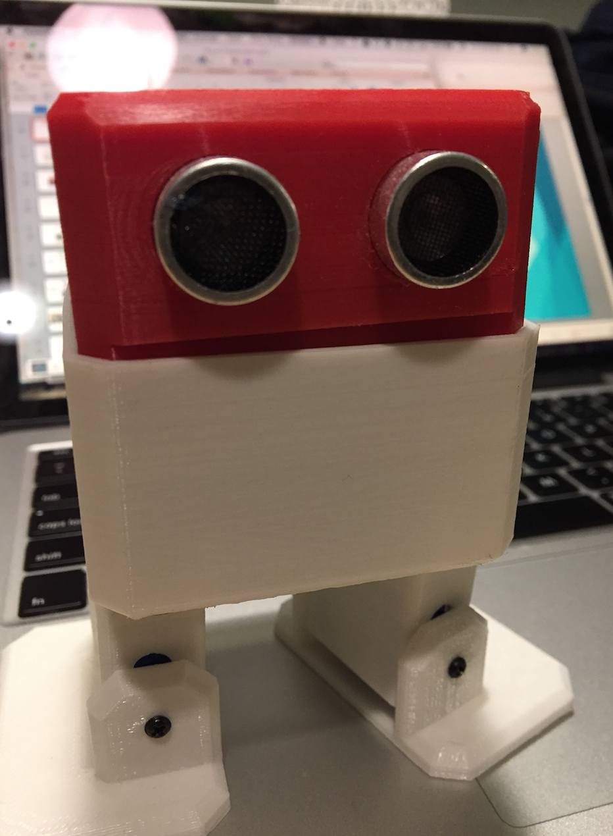
Otto the
Robot
Samuel Lum
Luan Dinh
Daniel Waters

Slide 2
OBJECTIVES
What is an Otto Robot?
How is he created?
Android App / Arduino Communication
How does Otto move?
How does Otto make sound?
How Otto “sees”?
Show robot in action

Slide 3
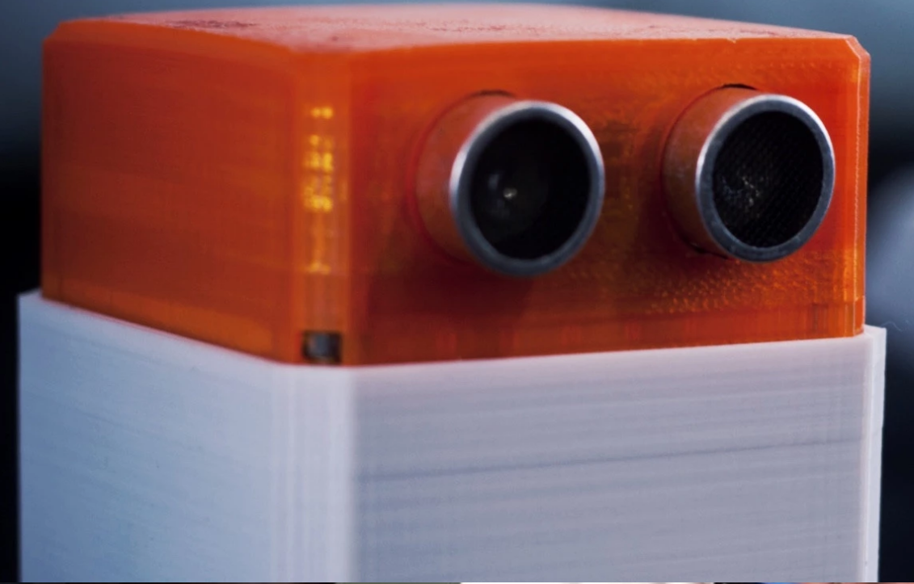
Who is Otto?

Slide 4
Otto
Otto is an interactive robot.
Our Otto can walk, dance, make sounds, and avoid obstacles.
It is controlled through an Android application just like a RC car. Giving it options to move forward, backward, left/right, and play music.

Slide 5
Otto
Otto, is an open source design for a robot found at http://otto.strikingly.com.
The website supplies 3D printer design files for the pieces needed to build the robot and electrical wiring diagrams.
While the outer shell of Otto is given, the abilities for Otto is left up to the user to design themselves.

Slide 6
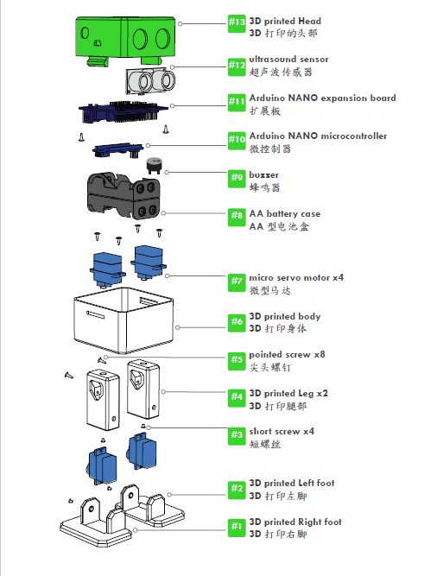
Parts
Diagram

Slide 7
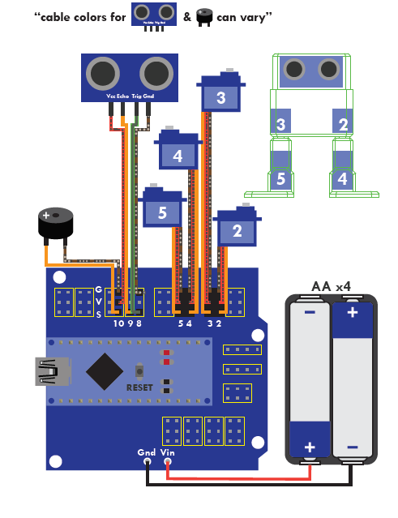
Electrical
Diagram

Slide 8
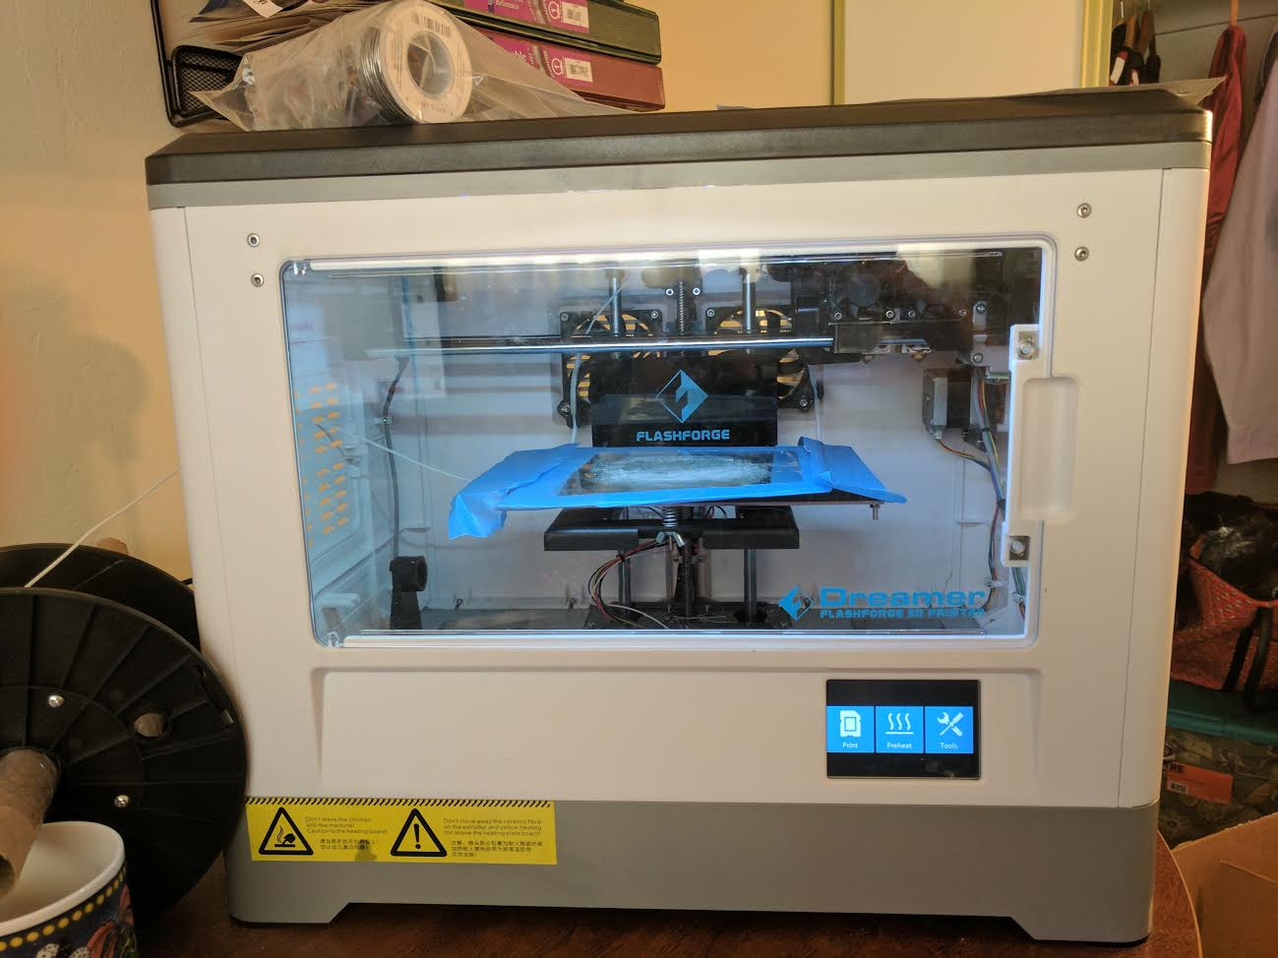
How is Otto
created?

Slide 9
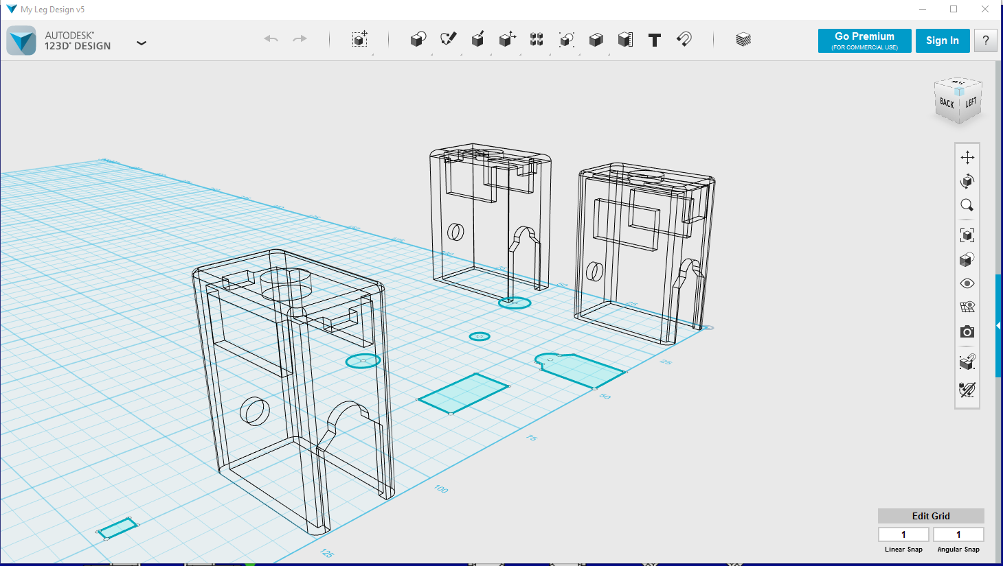
3D Design / Printer
A 3D printer prints files that are designed in 3D software such as Autodesk 123D Design using basic shapes.

Slide 10
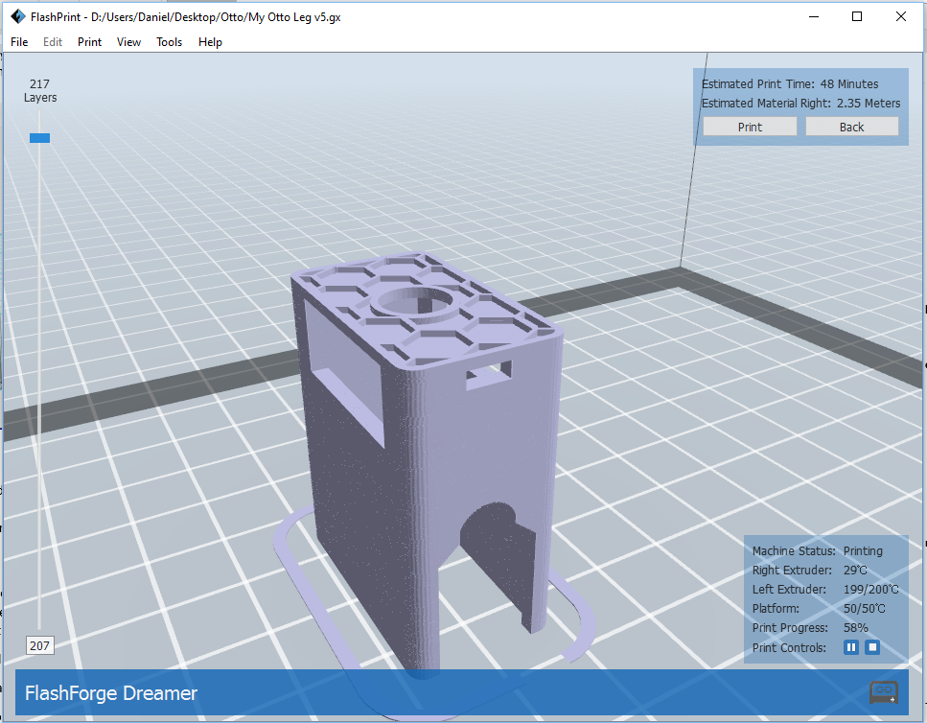
3D Design / Printer
Once the item has been designed, it is then sent to another program that takes the figure and slices it into 100’s or 1000’s of different layers. These layers create the blueprint for the printer.

Slide 11
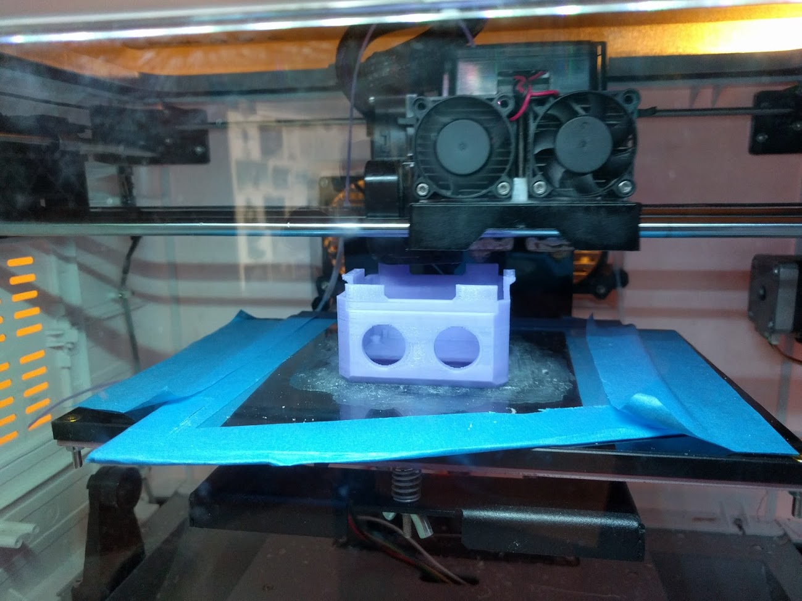
3D Design / Printer
The printer builds the figure by melting plastic to around 400°Fahrenheit, and then uses these tiny plastic droplets to build layers.

Slide 12
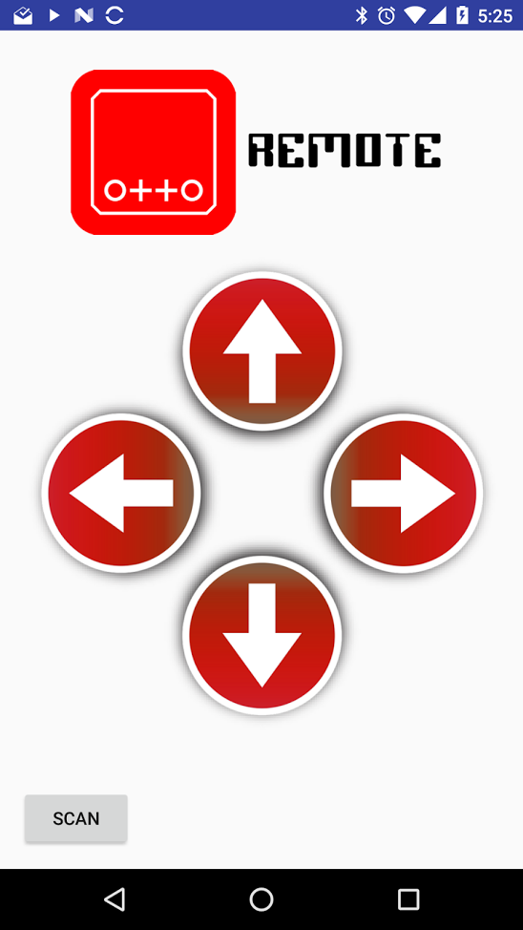
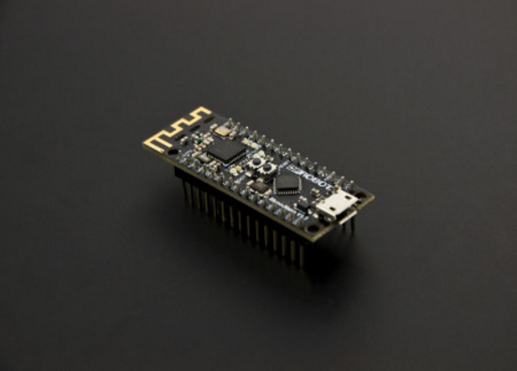
Android App
Arduino Communication

Slide 13
Android App
Android applications are typically built with Java, and run like most desktop applications with some additional requirements.
For example, Android applications require a GUI, called layout files, that allows the user to interact with the application.

Slide 14
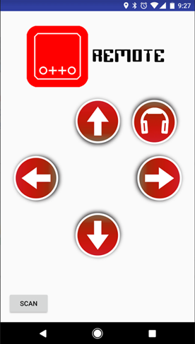
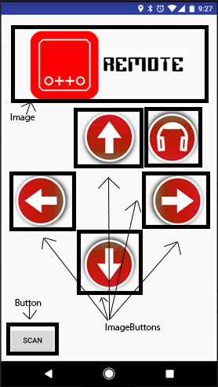
Otto Remote Layout

Slide 15
Layout Code
<ImageButton android:id="@+id/upButton" android:layout_width="@dimen/button_width" android:layout_height="@dimen/button_height" android:layout_below="@+id/logo" android:layout_centerHorizontal="true" android:background="@drawable/up_selector" android:scaleType="centerCrop"/>

Slide 16
Arduino Communication
We are using a BLUNO which is an Arduino Uno with built in Bluetooth capabilities.
The company who makes it, DFRobot, also supplies libraries and a starter Android application that will handle the connection with the Bluno.

Slide 17
Arduino Communication
This allows us to only concentrate on what we want to send and receive back from the hardware, not HOW to do it. Thanks to Object-Oriented Programming we only need to extend the BlunoLibrary class and we receive all the methods we need to communicate with the hardware.

Slide 18
Arduino Communication
Using OnClickListeners, once a button is pressed, we call the method serialSend() to send a String to the Bluno.
// Button to move Otto forward buttonUp = (ImageButton) findViewById(R.id.upButton); buttonUp.setOnClickListener(new OnClickListener() { @Override public void onClick(View view) { long diff = System.currentTimeMillis() - startTime; // Only send the command if the last one was over a second ago // To allow Otto to finish the movement if (System.currentTimeMillis() > startTime + 1000) { serialSend("F"); startTime = System.currentTimeMillis(); } } });

Slide 19
Arduino Communication
The Arduino code is a simple SWITCH/CASE statement that makes a decision based on the input from the Serial port.
if(Serial.available()) {
char character = Serial.read();
switch(character) {
case 'F':
Serial.println("MOVING OTTO UP");
if (safeDistance()) {
walk(2, t*2);
} else {
tone(10, 440, 1000);
}
break;

Slide 20
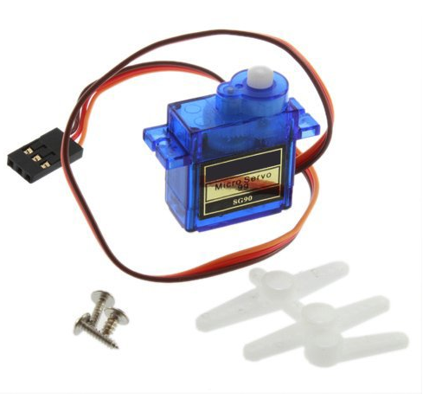
How does Otto
move?

Slide 21
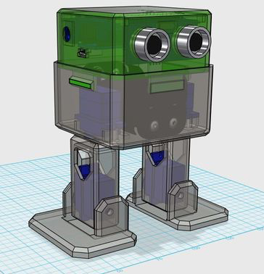
4 Servo Motors
Otto has four servo motors that collectively help the robot walk and dance. The upper legs rotate on the y-axis and the lower feet rotates on the z-axis.
At neutral position, servomotors can rotate 90 degrees to the left and 90 degrees to the right. This sums to 180 degrees of freedom for the rotor.
Servomotor 1
Servomotor 3
Servomotor 2
Servomotor 4

Slide 22
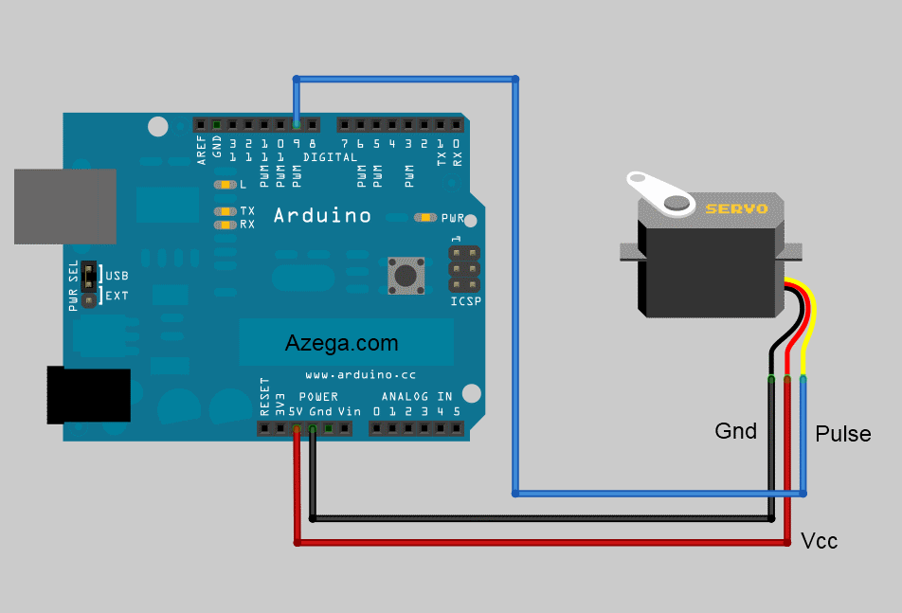
Servomotor Wiring
“Rotor Degrees Line”
(Sine Wave)
“Power Line”
(Square Wave)

Slide 23
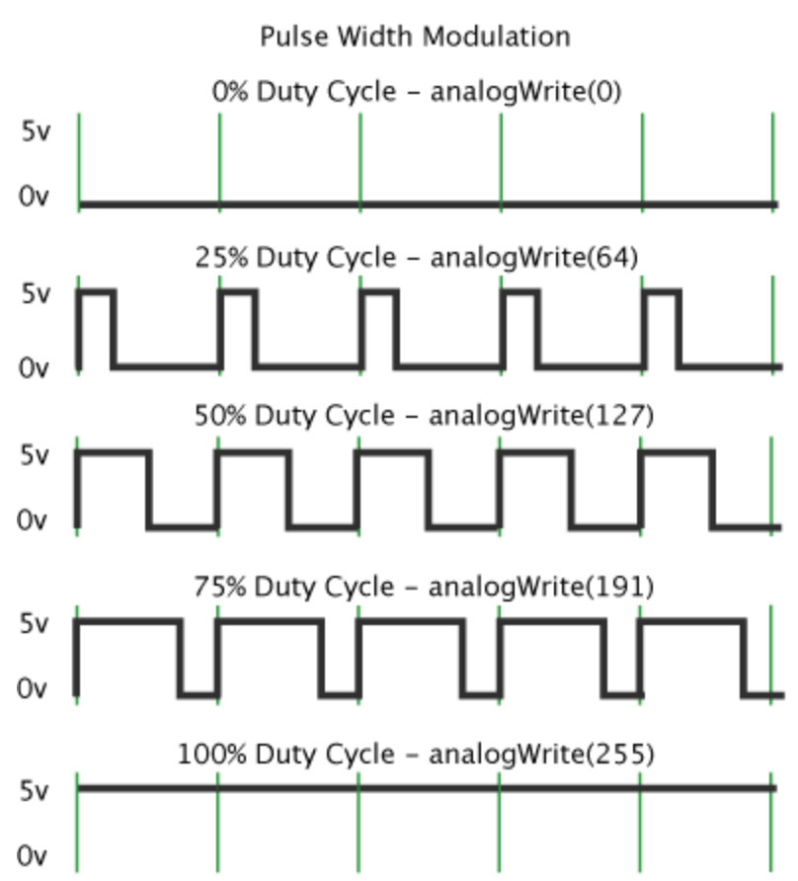
Square Signals (Power)
PWM (Pulse-Width Modulation) is the use of digital control to signal a servomotor. Our attach() and detach() functions has the option of attaching to a pin intermittently using PWM. The signal is binary (0v or 5v).
The Pulse width is the width of how long the pulse is on.

Slide 24
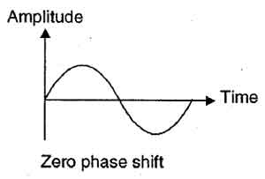
Sine Signals (0° to 180°)
An Oscillator produces a signal that varies in amplitude for a certain amount of time. We use an oscillator program to generate smooth movement in the servomotors rotor. This can also be done manually with multiple servoWrite() commands. For example, the servo motor can be told to manually increase 1 degree at a time but it will be noticeably erratic.
In our program our wave has four qualities:
Amplitude (degrees)
Offset (degrees)
Period (miliseconds)
Phase (radians)

Slide 25
Sweeping Servo Code
Servo myservo; // create servo object to control a servo
// twelve servo objects can be created on most boards
int pos = 0; // variable to store the servo position
void seup() {
myservo.attach(9); // attaches the servo on pin 9 to the servo object
}
void loop() {
for (pos = 0; pos <= 180; pos += 1) { // goes from 0 degrees to 180 degrees
// in steps of 1 degree
myservo.write(pos); // tell servo to go to position in variable 'pos'
delay(15); // waits 15ms for the servo to reach the position
}
for (pos = 180; pos >= 0; pos -= 1) { // goes from 180 degrees to 0 degrees
myservo.write(pos); // tell servo to go to position in variable 'pos'
delay(15); // waits 15ms for the servo to reach the position
}
}

Slide 26
Oscillate Code
void oscillate(int A[N_SERVOS], int O[N_SERVOS], int T, double phase_diff[N_SERVOS]){
// Sets the four qualities of the sinusoidal wave for each servomotor.
for (int i=0; i<4; i++) {
servo[i].SetO(O[i]);
servo[i].SetA(A[i]);
servo[i].SetT(T);
servo[i].SetPh(phase_diff[i]);
}
double ref=millis();
for (double x=ref; x<T+ref; x=millis()){
for (int i=0; i<4; i++){
servo[i].refresh(); // Samples the servomotors for oscillations and moves servomotors if it detects no oscillations.
}}}
void walk(int steps, int T){
int A[4]= {15, 15, 30, 30}; // Sets the degrees for each servomotor.
int O[4] = {0, 0, 0, 0};
double phase_diff[4] = {DEG2RAD(0), DEG2RAD(0), DEG2RAD(90), DEG2RAD(90)};
for(int i=0;i<steps;i++)oscillate(A,O, T, phase_diff);
}

Slide 27
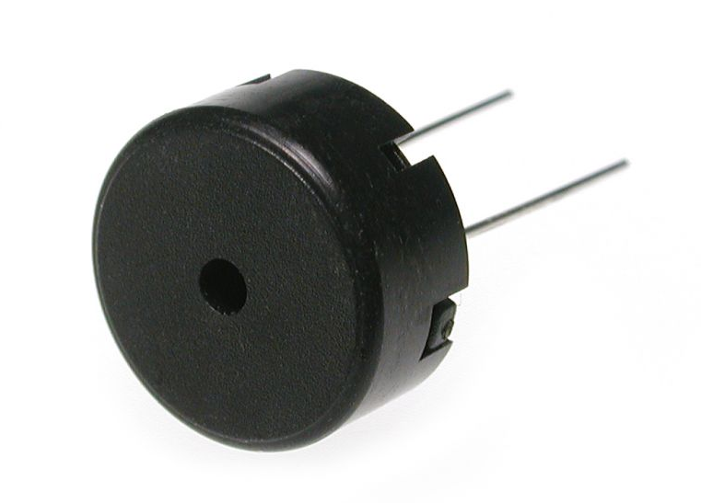
How does Otto
make sound?

Slide 28
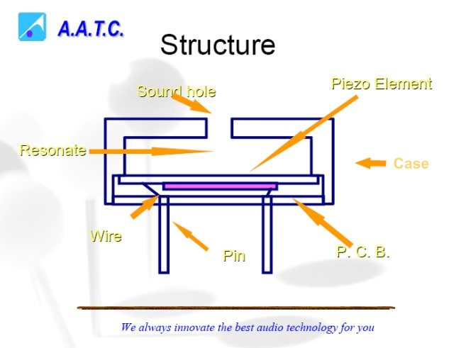
Piezo Buzzer

Slide 29
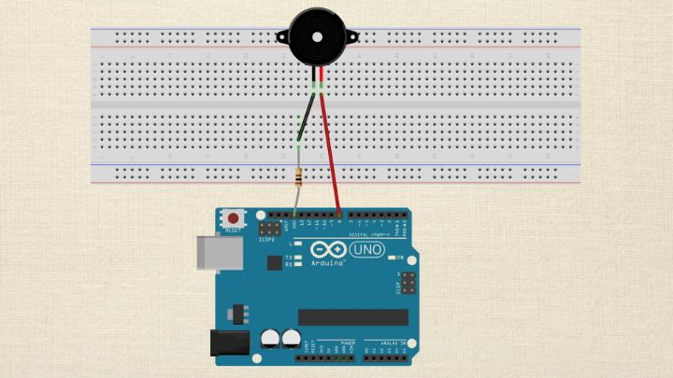
Piezo Buzzer
*Uses piezoelectric buzzer to make sound
*By attaching a piezo-electric disc to a thin metal plate, and apply electricity. We can bend the metal back and forth, which in turn creates noise.

Slide 30
Tone() function
Syntax:
Tone(pin, frequency)
Tone(pin, frequency, duration)
Parameter:
Pin Number: the pin that to generate the tone
Frequency: it is specified in hertz. Hertz are cycles per second. Unsigned int.
Duration: how long you want a tone to play. It is in milliseconds.
Return:
Nothing
Example:
Tone(10, 1000, 500)
Pin number: 10
Frequency: 1000
Duration: 500

Slide 31
Tone() function (more)
Frequency value can take up to 65,535 Hz.
For human ear’s values between 2000-5000 are recommended.
Uses one of the built in functions on the Arduino’s micro-controller.
Limits:
Cannot generate a tone lower than 31hz.
Tone() function cannot be used by two separate pins at the same time.

Slide 32
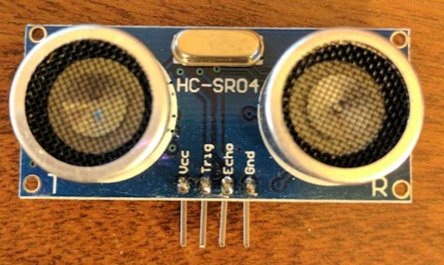
How does Otto
“see”?

Slide 33
Ultrasonic Sensor
-Ultrasonic Sensor, generates high-frequency sound waves, and uses the echo that is received back to calculate distances just like how a bat or dolphin uses echo location.
Humans can typically hear between 20Hz to 20kHz, while the sound produced by this sensor is 40kHz, much too high for humans to hear.

Slide 34
Ultrasonic Sensor
When the “Trig” pin of the sensor receives 5Volts (HIGH), it begins to send out sound waves.
After a very short period, about 10 microseconds, the sound waves are shut off. This tells the sensor to now begin to hear for the return of the sound waves through the “Echo” pin of the sensor.
Once sound waves are heard, 5V (HIGH) is sent down the “Echo” pin of the sensosr

Slide 35
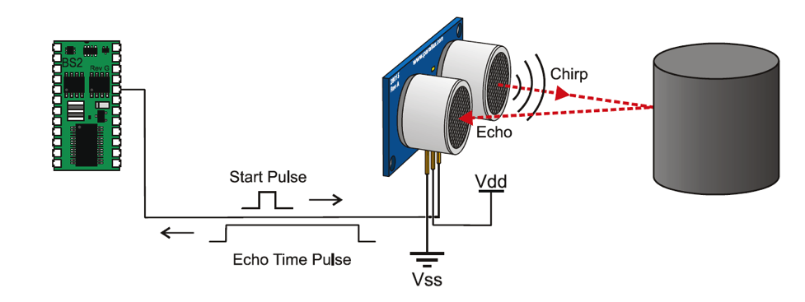
Ultrasonic Sensor

Slide 36
safeDistance() function
bool safeDistance() {
long duration, distance;
digitalWrite(trigPin, LOW); // Make sure not sending any sound
delayMicroseconds(2); // Clears the speaker for 2 microseconds
digitalWrite(trigPin, HIGH); // Start sound waves
delayMicroseconds(10); // Run for 10 microseconds
digitalWrite(trigPin, LOW); // Turn off sound waves
duration = pulseIn(echoPin, HIGH); // Set the echo pin to wait for 5V
distance = (duration/2) * 0.03435; // (Distance = Speed * Time)
return (distance > 5);
}

Slide 37
Finished Robot
demonstration

